Slide 1
Estimating the number of undetected COVID-19 cases in Australia through Capture-Recapture methods Dr Joanne Thandrayen Joanne.Thandrayen@anu.edu.au National Centre for Epidemiology & Population Health Joint work with Dr Bernard Baffour, School of Demography
Australasian Applied Statistics Conference, Victoria, 1 December 2022

Slide 2
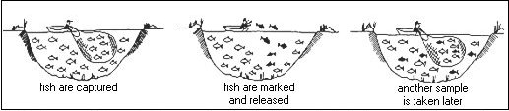

Capture-Recapture (CRc) methods – animal population
Background
Capture-recapture methods originated in ecology to estimate the size of an unknown animal population.
Two-Sample problem:
Total population size is estimated by:
Source: https://www.plslwd.org/2016/07/carp-management-update/mark-recapture-diagram/
$$\frac{n_{1}×n_{2}}{n_{12}}$$

Slide 3
CRc methods – human population
Background
These methods have now been extensively used in epidemiology and public health.
Two-Source problem:

Slide 4
Coronavirus disease 2019 (COVID-19)
Background
Worldwide, most countries have publicly reported their daily counts of confirmed COVID-19 cases and related deaths.
Nevertheless, there remains a substantial number of undetected infections due to various factors (e.g. difficulties in identification of asymptomatic cases, delayed symptoms, rapidly evolving variants and strains, efficacy of contract tracing).
For these reasons, the total number of COVID-19 cases is unknown.

Slide 5
COVID-19 in Australia
Background
Australia has been one of the few developed countries in the world that has successfully slowed down the spread of COVID-19 by introducing a number of public health measures (e.g. closure of Australian borders, quarantine for returning residents, lockdowns in individual states and territories, social distancing rules, rollout of vaccinations).
As a result, Australia has experienced lower infection and death rates than many comparable developed countries (15,146 deaths out of over 10 million confirmed cases of the disease, as of 21 November 2022^{[1]}).
However, these figures are only those reported and collected by the state/territory official health systems, and as such can under-estimate the true magnitude of the pandemic.

Slide 6
Aims
Aims & Methods
To provide a lower bound and upper bound estimates of the true number of COVID-19 cases in Australia during the first wave of the pandemic (March-April 2020).
To also provide those estimates for 5 states (New South Wales, Victoria, Queensland, Western Australia, and Tasmania).
Methods
Data
“COVID-19 in Australia” publicly available database on GITHUB^{[2]}
cumulative confirmed COVID-19 cases and cumulative deaths occurring in Australia daily; similar information was available by States and Territories

Slide 7
Table 1: Cumulative counts of COVID-19 infections and deaths from COVID-19 in Australia starting from t₀ = 3 March 2020 to t_{m} = 1 April 2020
Methods
Observational period
25 January 2020: first 4 cases of COVID-19 recorded in Australia
3 March 2020: first related death
We analysed data over 30 days starting from the day on which the first death was recorded.

Slide 8
Methods
Statistical approach
Böhning et al. (2020)^{[3]}: CRc lower bound estimator
Rocchetti et al. (2020)^{[4]}: CRc upper bound estimator
Notation
Let t₀ and t_{m} denote the start and end of an observational period respectively.
Let N(t) and D(t) denote the cumulative count of infections and deaths respectively at day t (t=t₀,⋯,t_{m}).
The number of new infections and deaths at day t is thus ∆N(t)=N(t)-N(t-1) and ∆D(t)=D(t)-D(t-1) respectively.

Slide 9
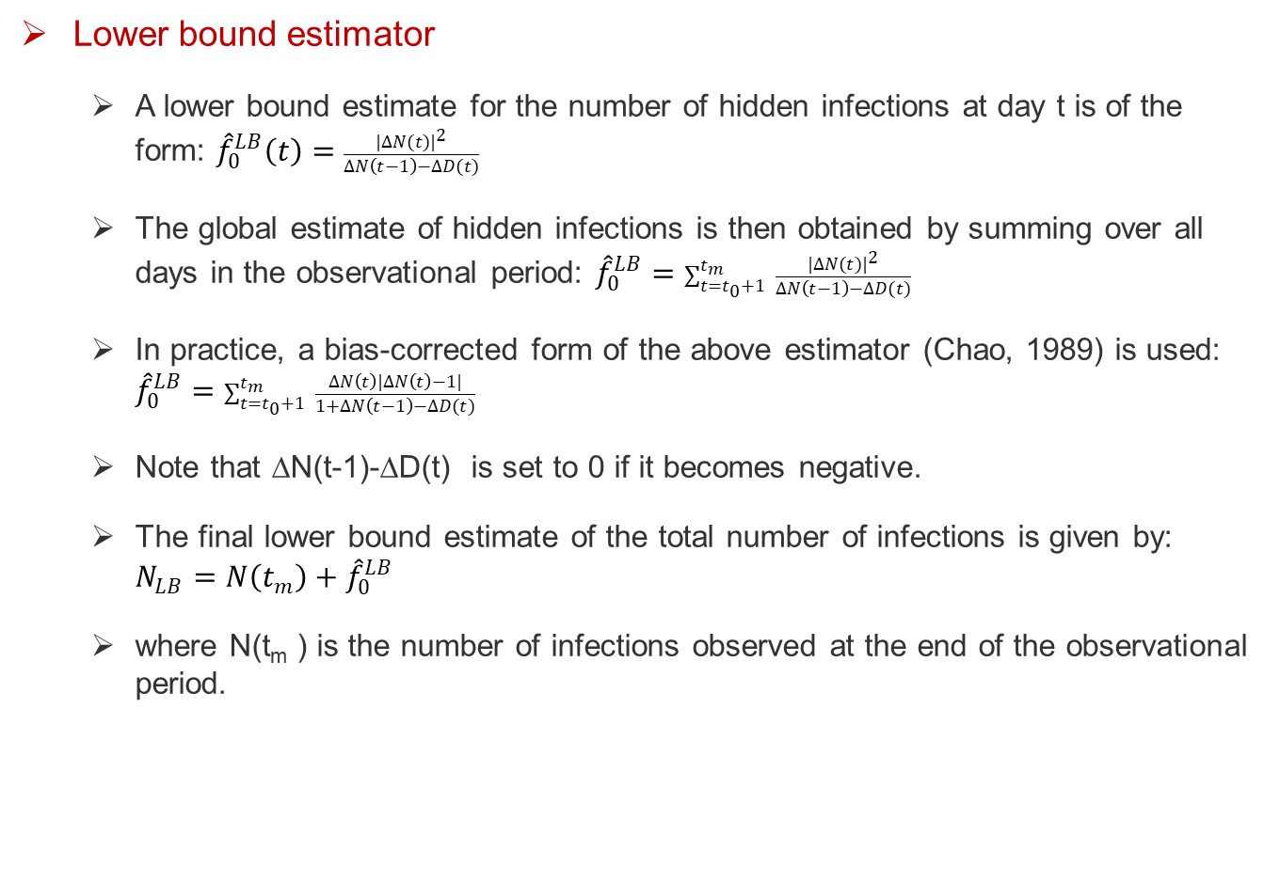
Methods
Lower bound estimator
A lower bound estimate for the number of hidden infections at day t is of the form: ${\hat{f}}_{0}^{LB}\left(t\right)=\frac{{|∆N(t)|}^{2}}{∆N\left(t−1\right)−∆D(t)}$
The global estimate of hidden infections is then obtained by summing over all days in the observational period: ${\hat{f}}_{0}^{LB}=\sum_{t=t_{0}+1}^{t_{m}}{ \frac{{|∆N(t)|}^{2}}{∆N\left(t−1\right)−∆D(t)}}$
In practice, a bias-corrected form of the above estimator (Chao, 1989) is used: ${\hat{f}}_{0}^{LB}=\sum_{t=t_{0}+1}^{t_{m}}{ \frac{∆N\left(t\right)|∆N\left(t\right)−1|}{1+∆N\left(t−1\right)−∆D(t)}}$
Note that ∆N(t-1)-∆D(t) is set to 0 if it becomes negative.
The final lower bound estimate of the total number of infections is given by: $N_{LB}=N\left(t_{m}\right)+{\hat{f}}_{0}^{LB}$
where N(t_{m} ) is the number of infections observed at the end of the observational period.

Slide 10
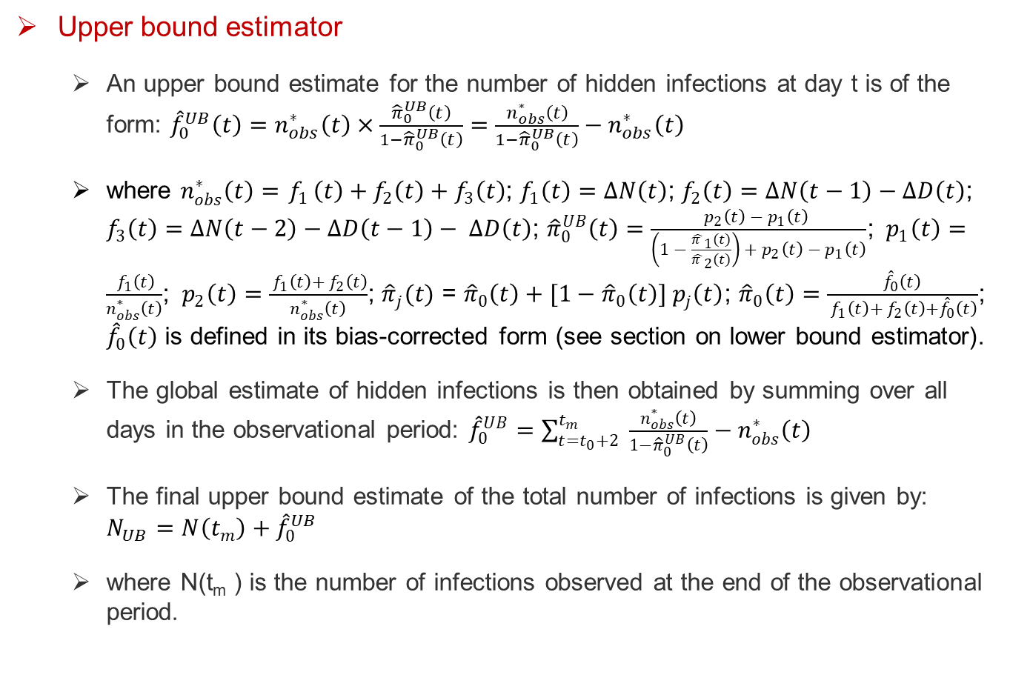
Methods
Upper bound estimator
An upper bound estimate for the number of hidden infections at day t is of the form: ${\hat{f}}_{0}^{UB}\left(t\right)=n_{obs}^{∗}\left(t\right)×\frac{{\hat{π}}_{0}^{UB}\left(t\right)}{1−{\hat{π}}_{0}^{UB}\left(t\right)}=\frac{n_{obs}^{∗}\left(t\right)}{1−{\hat{π}}_{0}^{UB}\left(t\right)}−n_{obs}^{∗}\left(t\right)$
where $n_{obs}^{∗}\left(t\right)={ f}_{1}\left(t\right)+f_{2}\left(t\right)+f_{3}\left(t\right)$; $f_{1}\left(t\right)=∆N\left(t\right)$; $f_{2}\left(t\right)=∆N\left(t−1\right)−∆D\left(t\right)$; $f_{3}\left(t\right)=∆N\left(t−2\right)−∆D\left(t−1\right)− ∆D\left(t\right)$; ${\hat{π}}_{0}^{UB}\left(t\right)=\frac{p_{2}\left(t\right) −{ p}_{1}\left(t\right) }{\left(1 − \frac{{\hat{π }}_{1}(t)}{{\hat{π }}_{2}(t)}\right) + p_{2}\left(t\right) −{ p}_{1}\left(t\right)}$; ${ p}_{1}\left(t\right)=\frac{{ f}_{1}\left(t\right)}{n_{obs}^{∗}\left(t\right)}$; ${ p}_{2}\left(t\right)=\frac{{ f}_{1}\left(t\right)+{ f}_{2}\left(t\right)}{n_{obs}^{∗}\left(t\right)}$; ${\hat{π}}_{j}(t)$ = ${\hat{π}}_{0}\left(t\right)+[1−{\hat{π}}_{0}\left(t\right)]{ p}_{j}\left(t\right)$; ${\hat{π}}_{0}\left(t\right)=\frac{{\hat{f}}_{0}\left(t\right)}{{ f}_{1}\left(t\right)+{ f}_{2}\left(t\right)+{\hat{f}}_{0}\left(t\right)}$; ${\hat{f}}_{0}\left(t\right)$ is defined in its bias-corrected form (see section on lower bound estimator).
The global estimate of hidden infections is then obtained by summing over all days in the observational period: ${\hat{f}}_{0}^{UB}=\sum_{t=t_{0}+2}^{t_{m}}{ \frac{n_{obs}^{∗}\left(t\right)}{1−{\hat{π}}_{0}^{UB}\left(t\right)}−n_{obs}^{∗}\left(t\right)}$
The final upper bound estimate of the total number of infections is given by: $N_{UB}=N\left(t_{m}\right)+{\hat{f}}_{0}^{UB}$
where N(t_{m} ) is the number of infections observed at the end of the observational period.

Slide 11
Table 2: Estimated hidden and total cases of COVID-19 for Australia and its states/territories, April 2020
Results

Slide 12
Results
Our results showed that, in general, the total number of cases was at least twice and at most four times the observed number of cases reported in Australia.
A ratio (total/observed) of 2 and 4 implied that for every confirmed case of COVID-19 there were 2 to 4 people with COVID-19 respectively but the latter have not been identified by the official health systems.
There were differences at the state levels with New South Wales having the highest ratio and Victoria the lowest ratio.

Slide 13
Conclusion
The lower bound estimator provides an indication of the minimum number of people having had COVID-19. In other words, it is an estimate of the best possible scenario. On the other hand, the upper bound estimator provides an estimation of the worst possible scenario.
Overall, the results confirmed that the COVID-19 outbreak was more prevalent than what has been officially recorded by the state/territory health departments.
These results are important to better appreciate the spread and impact of the COVID-19 pandemic for health monitoring, planning and evaluation.

Slide 14


Slide 15
References
[1] WHO. Coronavirus (COVID-19) Dashboard by country. WHO Coronavirus (COVID-19) Dashboard with Vaccination Data. Available online: https://covid19.who.int/region/wpro/country/au (accessed on 22 November 2022).
[2] GITHUB. COVID-19 Data for Australia. Available online: https://github.com/M3IT/COVID-19_Data (accessed on 16 September 2021).
[3] Böhning, D., Rocchetti, I., Maruotti, A., & Holling, H. (2020). Estimating the undetected infections in the Covid-19 outbreak by harnessing capture–recapture methods. International Journal of Infectious Diseases, 97, 197-201.
[4] Rocchetti, I., Böhning, D., Holling, H., & Maruotti, A. (2020). Estimating the size of undetected cases of the COVID-19 outbreak in Europe: An upper bound estimator. Epidemiologic Methods 2, 9.

